Slide 1
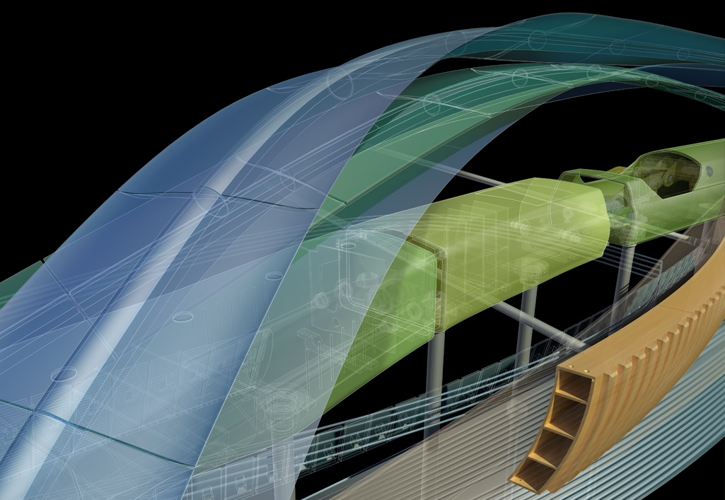
Assembly Document – Advanced topics
Presenter
Developer Technical Services

Slide 2
Agenda
Connection
iMates
Assembly Features
BOM API
iAssemblies
Assembly Representations:
Design Views
Positional
Level of Detail
File References

Slide 3
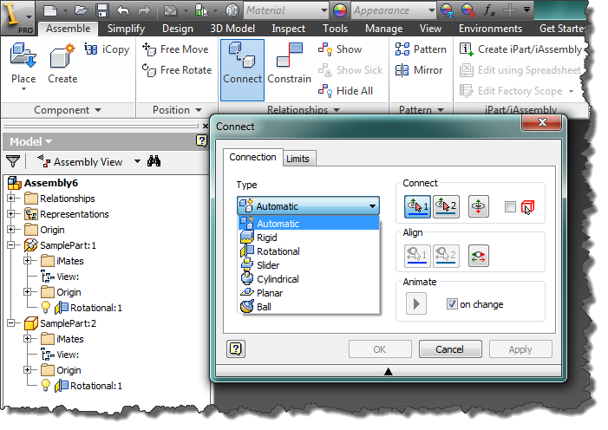
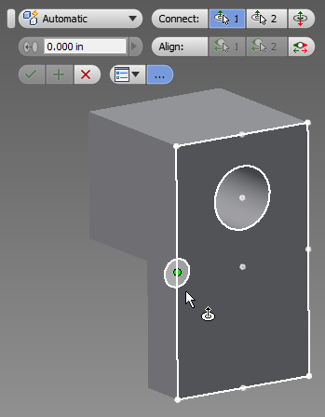
Connection (from 2014)
More real world termology
Connect with quite few constraints to have the effect
Inventor will return some good graphics to indicate the relationship of the bodies
Full API is supported from 2014
Full API Support
Notes:
Connection we have had it in product already. Now in this release,It is pretty powerful.
We add API support. New type of constraint. Whole goal to it can be used to
It mainly really to be used than constraint.
In the language the engineers can understand.
You would not think a mate.
Connection is more real world a termolodyg . You can do something connectios with quite few constraints to have the effect. When you try to connection, Inventor will return some good graphics to indicate the relationship of the bodies.
There is full api in this realse.

Slide 4
Connection (from 2014)
Connections
Collection of connections in the assembly
Connections.CreateAssemblyConnectionDefinition
Create a connection definition
AssemblyConnection
Object of connection
Connections.Add
Add a connection with the definition
' Create two intents to define the geometry for the connection. assume two faces are available
Dim intentOne As GeometryIntent
intentOne = asmDef.CreateGeometryIntent(Face1, PointIntentEnum.kPlanarFaceCenterPointIntent)
Dim intentTwo As GeometryIntent
intentTwo = asmDef.CreateGeometryIntent(Face2, PointIntentEnum.kPlanarFaceCenterPointIntent)
' Create a rigid connection between the two parts.
Dim connectDef As AssemblyConnectionDefinition
connectDef = asmDef.Connections.CreateAssemblyConnectionDefinition(
AssemblyConnectionTypeEnum.kRigidConnectionType,
intentOne, intentTwo)
connectDef.FlipAlignmentDirection = False
connectDef.FlipOriginDirection = True
Dim connect As AssemblyConnection
connect = asmDef.Connections.Add(connectDef)
' Make the connection visible.
connect.Visible = True

Slide 5
iMates
In the API, iMates consist of two parts:
iMate Definition – The iMate in the part or subassembly.
iMate Result – The result of combining two iMates in an assembly.

Slide 6
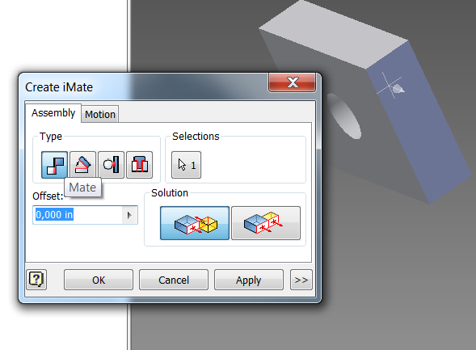
iMateDefinition Creation
The ComponentDefinition.iMateDefinitions object provides various Add Methods:
AddAngleiMateDefinition
AddCompositeiMateDefinition
AddFlushiMateDefinition
AddInsertiMateDefinition
AddMateiMateDefinition
AddRotateRotateiMateDefinition
AddRotateTranslateiMateDefinition
AddTangentiMateDefinition
Each Add Method has an optional MatchList argument:
Array of Strings that specifies the priority order of the iMate definitions to match.

Slide 7
iMateDefinition Example 1/2
Public Sub CreateiMateDefinition()
' Create a new part document, using the default part template.
Dim oPartDoc As PartDocument
oPartDoc = _InvApplication.ActiveDocument
' Set a reference to the component definition.
Dim oCompDef As PartComponentDefinition
oCompDef = oPartDoc.ComponentDefinition
'get first extrude feature
Dim oExtrude1 As ExtrudeFeature
oExtrude1 = oCompDef.Features.ExtrudeFeatures(1)
' Get the top face of the extrusion to use for creating the new sketch.
Dim oFrontFace As Face
oFrontFace = oExtrude1.StartFaces.Item(1)
' Create the second extrude (assume it is a hole).
Dim oExtrude2 As ExtrudeFeature
oExtrude2 = oCompDef.Features.ExtrudeFeatures(2)
' Create a mate iMateDefinition on a side face of the first extrude.
Dim oMateiMateDefinition As MateiMateDefinition
oMateiMateDefinition = oCompDef.iMateDefinitions.AddMateiMateDefinition( _
oExtrude1.SideFaces.Item(1), 0, , , "MateA")

Slide 8
iMateDefinition Example 2/2
' Create a match list of names to use for the next iMateDefinition.
Dim strMatchList(2) As String
strMatchList(0) = "InsertA"
strMatchList(1) = "InsertB"
strMatchList(2) = "InsertC"
' Create an insert iMateDefinition on the cylindrical face of the second extrude.
Dim oInsertiMateDefinition As InsertiMateDefinition
oInsertiMateDefinition = oCompDef.iMateDefinitions.AddInsertiMateDefinition( _
oExtrude2.SideFaces.Item(1), False, 0, , "InsertA", strMatchList)
End Sub

Slide 9
iMateResult Creation
The AssemblyComponentDefinition.iMateResults object provides 2 Add Methods:
AddByTwoiMates
Using 2 iMateDefinition objects
AddByiMateAndEntity
1 iMateDefinition and one geometric entity (WorkAxis, SketchLine, Face, …)
Notes:
Public Sub iMateResultCreation()
' Get the component definition of the currently open assembly.
' This will fail if an assembly document is not open.
Dim oAsmCompDef As AssemblyComponentDefinition
oAsmCompDef = _InvApplication.ActiveDocument.ComponentDefinition
' Create a new matrix object. It will be initialized to an identity matrix.
Dim oMatrix As Matrix
oMatrix = _InvApplication.TransientGeometry.CreateMatrix
' Place the first occurrence.
Dim oOcc1 As ComponentOccurrence
oOcc1 = oAsmCompDef.Occurrences.Add("C:\\Temp\\iMatePart.ipt", oMatrix)
' Place the second occurrence, but adjust the matrix slightly so they're
' not right on top of each other.
oMatrix.Cell(1, 4) = 10
Dim oOcc2 As ComponentOccurrence
oOcc2 = oAsmCompDef.Occurrences.Add("C:\\Temp\\iMatePart.ipt", oMatrix)
' Look through the iMateDefinitions defined for the first occurrence
' and find the one named "iMate:1". This loop demonstrates using the
' Count and Item properties of the iMateDefinitions object.
Dim i As Long
Dim oiMateDef1 As iMateDefinition
For i = 1 To oOcc1.iMateDefinitions.Count
If oOcc1.iMateDefinitions.Item(i).Name = "iMate:1" Then
oiMateDef1 = oOcc1.iMateDefinitions.Item(i)
Exit For
End If
Next
If oiMateDef1 Is Nothing Then
MsgBox("An iMate definition named ""iMate:1"" does not exist in " & oOcc1.Name)
Exit Sub
End If
' Look through the iMateDefinitions defined for the second occurrence
' and find the one named "iMate:1". This loop demonstrates using the
' For Each method of iterating through a collection.
Dim oiMateDef2 As iMateDefinition
Dim bFoundDefinition As Boolean
For Each oiMateDef2 In oOcc2.iMateDefinitions
If oiMateDef2.Name = "iMate:1" Then
bFoundDefinition = True
Exit For
End If
Next
If Not bFoundDefinition Then
MsgBox("An iMate definition named ""iMate:1"" does not exist in " & oOcc2.Name)
Exit Sub
End If
' Create an iMate result using the two definitions.
Dim oiMateResult As iMateResult
oiMateResult = oAsmCompDef.iMateResults.AddByTwoiMates(oiMateDef1, oiMateDef2)
End Sub

Slide 10
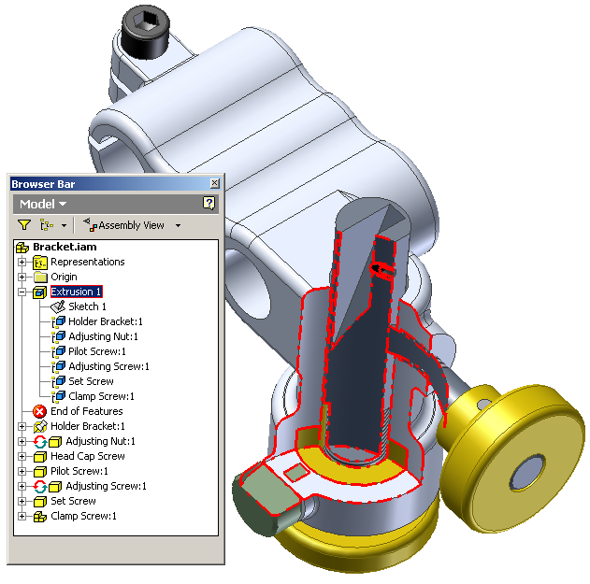
Assembly Features
Assembly features only exist in an assembly: only impacts the part as it exists in the assembly. The original part is unchanged.
The API reuses same PartFeature objects used in Part document.
Assembly Features have limited functionality: can only remove material, not all extent types supported, not all features supported.
Use RemoveParticipant / AddParticipant methods to control which parts are involved in the feature.

Slide 11
Assembly Feature Example
Public Sub AssemblyFeature()
Dim oAsmDef As AssemblyComponentDefinition
oAsmDef = _InvApplication.ActiveDocument.ComponentDefinition
' Create a sketch on the XY workplane.
Dim oSketch As PlanarSketch
oSketch = oAsmDef.Sketches.Add(oAsmDef.WorkPlanes.Item(3))
Dim oTG As TransientGeometry
oTG = _InvApplication.TransientGeometry
' Draw a rectangle.
oSketch.SketchLines.AddAsTwoPointRectangle(oTG.CreatePoint2d(0.1, 0.1), _
oTG.CreatePoint2d(1, 0.5))
' Create a profile
Dim oProfile As Profile
oProfile = oSketch.Profiles.AddForSolid
' Create the extrusion.
Dim oExtrudeDef As ExtrudeDefinition
oExtrudeDef = oAsmDef.Features.ExtrudeFeatures.CreateExtrudeDefinition(oProfile, PartFeatureOperationEnum.kCutOperation)
oExtrudeDef.SetDistanceExtent("2 cm", PartFeatureExtentDirectionEnum.kSymmetricExtentDirection)
oAsmDef.Features.ExtrudeFeatures.Add(oExtrudeDef)
End Sub
Notes:
Public Sub AssemblyFeature()
Dim oAsmDef As AssemblyComponentDefinition
Set oAsmDef = ThisApplication.ActiveDocument.ComponentDefinition
' Create a sketch on the XY workplane.
Dim oSketch As PlanarSketch
Set oSketch = oAsmDef.Sketches.Add(oAsmDef.WorkPlanes.Item(3))
' Draw a rectangle.
Call oSketch.SketchLines.AddAsTwoPointRectangle(oTG.CreatePoint2d(0.1, 0.1), _
oTG.CreatePoint2d(1, 0.5))
' Create a profile
Dim oProfile As Profile
Set oProfile = oSketch.Profiles.AddForSolid
' Create the extrusion.
Call oAsmDef.Features.ExtrudeFeatures.AddByThroughAllExtent(oProfile, _
kPositiveExtentDirection, kCutOperation)
End Sub

Slide 12
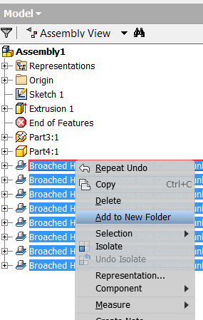
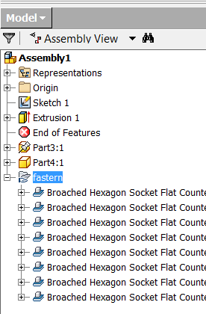
User‐defined Assembly Folders
Public Sub AddAssemblyBrowserFolder()
Dim oDoc As AssemblyDocument
oDoc = _InvApplication.ActiveDocument
Dim oDef As AssemblyComponentDefinition
oDef = oDoc.ComponentDefinition
Dim oPane As BrowserPane
oPane = oDoc.BrowserPanes.ActivePane
' Create an object collection
Dim oOccurrenceNodes As ObjectCollection
oOccurrenceNodes = _InvApplication.TransientObjects.CreateObjectCollection
Dim oOcc As ComponentOccurrence
For Each oOcc In oDef.Occurrences
' Get the node associated with this occurrence.
Dim oNode As BrowserNode
oNode = oPane.GetBrowserNodeFromObject(oOcc)
' Add the node to the collection.
oOccurrenceNodes.Add(oNode)
Next
' Add the folder to the browser and specify the nodes to be grouped within it.
Dim oFolder As BrowserFolder
oFolder = oPane.AddBrowserFolder("My Occurrences Folder", oOccurrenceNodes)
End Sub
Notes:
Organize the browser to communicate design intent through logical groupings
- Organize your assembly browser and improve workflow
Group browser nodes based on your own convention
Browse folders are a new feature that allow user-defined grouping of items in the tree view. These screenshots on this slide show before and after images of a browser folder. On the left you see the usual assembly view. On the right you see the user has created a custom folder and how did the logical set of parts to that folder. This makes the assembly tree much easier to read. Browse the folders are only supported in assemblies. They wouldn’t make much sense in a part, as the ordering of features determines the end result.
This is exposed through the API as well. Let’s take a look at a demo.
[The modAssembly.AddOccurrencesToFolder demonstrates this for an assembly.]
Public Sub AddAssemblyBrowserFolder ()
Dim oDoc As AssemblyDocument
Set oDoc = ThisApplication.ActiveDocument
Dim oDef As AssemblyComponentDefinition
Set oDef = oDoc.ComponentDefinition
Dim oPane As BrowserPane
Set oPane = oDoc.BrowserPanes.ActivePane
' Create an object collection
Dim oOccurrenceNodes As ObjectCollection
Set oOccurrenceNodes = ThisApplication.TransientObjects.CreateObjectCollection
Dim oOcc As ComponentOccurrence
For Each oOcc In oDef.Occurrences
' Get the node associated with this occurrence.
Dim oNode As BrowserNode
Set oNode = oPane.GetBrowserNodeFromObject(oOcc)
' Add the node to the collection.
oOccurrenceNodes.Add oNode
Next
' Add the folder to the browser and specify the nodes to be grouped within it.
Dim oFolder As BrowserFolder
Set oFolder = oPane.AddBrowserFolder("My Occurrences Folder", oOccurrenceNodes)
End Sub

Slide 13
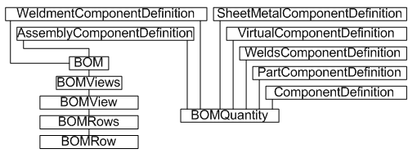
The Bom API
Public Sub BomAccess()
Dim oAsm As AssemblyDocument
oAsm = _InvApplication.ActiveDocument
Dim oBOM As BOM
oBOM = oAsm.ComponentDefinition.BOM
oBOM.StructuredViewEnabled = True
Dim oBomView As BOMView
oBomView = oBOM.BOMViews("Structured")
Dim rowIdx As Long
For rowIdx = 1 To oBomView.BOMRows.Count
Dim oRow As BOMRow
oRow = oBomView.BOMRows(rowIdx)
Debug.Print("ItemNumber: " & oRow.ItemNumber & " TotalQuantity = " & oRow.TotalQuantity)
Dim oCompDef As ComponentDefinition
oCompDef = oRow.ComponentDefinitions(1)
Dim oDesignPropSet As PropertySet
oDesignPropSet = oCompDef.Document.PropertySets("Design Tracking Properties")
Next
End Sub
Notes:
The BOM API can make additional changes to the BOM data, and can query and export that data. Autodesk Inventor makes use of PropertySet objects to store some BOM data for a component. Client code can access this data directly.
iProperties can be accessed through the Document accessed from the component definition

Slide 14
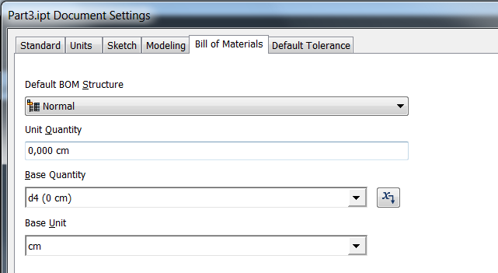
The BOMQuantity Object
BOMQuantity provides methods and properties allowing the BOM row unit quantity to be computed.
It provides programmatic access to the settings of the “Bill of Materials” Tab of Document Settings.
BOMQuantity.SetBaseQuantity Method allows to set a parameter as the Base Quantity
The BOMQuantity.BaseUnits Property indicates the true unit that the component is quantified in: It can be a measure of length, volume, or mass.
The BOMQuantity.UnitQuantity Property returns the value derived from BaseQuantity * BaseUnits.

Slide 15
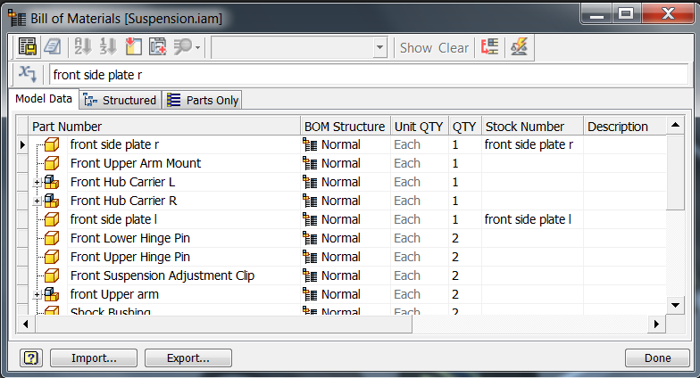
Global Bill of Materials (BOM)
Single BOM that is used by both the assembly and drawing.
The BOM controls the item numbers used by parts lists and balloons in the drawing.
BOMRow.TotalQuantity can be overriden since it is a Read/Write property. BOMRow.TotalQuantityOverridden can be used to know if the property has been overriden. BOMRow.TotalQuantityOverridden property can only be set to False, in which case the override on the value will be removed.
Notes:
Minimally, a BOM lists components, quantity, and relevant totals. Additionally, a BOM likely includes part or stock numbers, cut length figures, and so on. Autodesk Inventor can add all this information to a drawing in the form of a table.

Slide 16
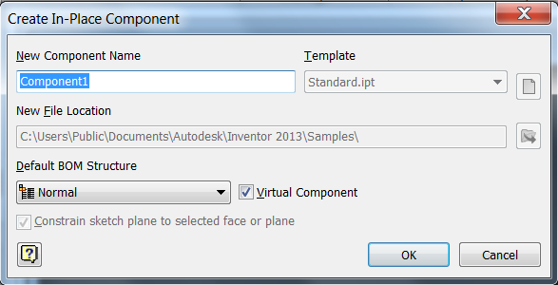
Global Bill of Materials (BOM)
The API supports creation and query of virtual parts.
Virtual parts are represented by a standard ComponentOccurrence object in the assembly.
The ComponentDefinition associated with a virtual part is a VirtualComponentDefinition object.

Slide 17
Exporting the BOM
Public Sub ExportBOM()
Dim oDoc As AssemblyDocument
oDoc = _InvApplication.ActiveDocument
Dim oBOM As BOM
oBOM = oDoc.ComponentDefinition.BOM
' Set the structured view to 'all levels'
oBOM.StructuredViewFirstLevelOnly = False
' Make sure that the structured view is enabled.
oBOM.StructuredViewEnabled = True
' Set a reference to the "Structured" BOMView
Dim oStructuredBOMView As BOMView
oStructuredBOMView = oBOM.BOMViews.item("Structured")
' Export the BOM view to an Excel file
oStructuredBOMView.Export("C:\Temp\BOM-StructuredAllLevels.xls", FileFormatEnum.kMicrosoftExcelFormat)
End Sub
Notes:
A typical use for the BOM API is to query and export data for a specific use, perhaps to be read by other software downstream.

Slide 18
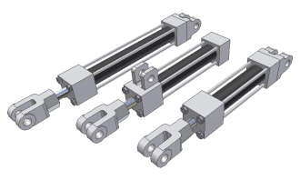
iAssemblies - API support
API support for:
Creation of an iAssembly factory
Access to the associated Excel work sheet
Access to row and column objects of the factory
Place/replace of iAssembly occurrences in assemblies
Ability to specify the member to use for a drawing view

Slide 19
iAssembly Objects
iAssemblies principle is similar to iParts with the existence of a Factory and Members objects.
AssemblyComponentDefinition.CreateFactory converts an assembly to an iAssemblyFactory. The newly created iAssemblyFactory object will have an empty excel spreadsheet
AssemblyComponentDefinition.iAssemblyFactory property provides access to the iAssemblyTable, the Excel sheet and member creation:
DefaultRow Property
TableColumns Property
TableRows Property
ExcelWorkSheet Property
CreateMember Method
AssemblyComponentDefinition.iAssemblyMember provides access to the iAssemblyMember object.

Slide 20
Add an iAssembly Member
Public Sub AddiAssemblyOccurrence()
Dim oDoc As AssemblyDocument
oDoc = _InvApplication.ActiveDocument
Dim oOccurrences As ComponentOccurrences
oOccurrences = oDoc.ComponentDefinition.Occurrences
Dim oTG As TransientGeometry
oTG = _InvApplication.TransientGeometry
Dim oPos As Matrix
oPos = oTG.CreateMatrix
Dim oNewOcc As ComponentOccurrence
'Row specified either by a Long (row index), String (MemberName), or iAssemblyTableRow.
oNewOcc = oOccurrences.AddiAssemblyMember("C:\MyiAsm.iam", oPos, 1)
oNewOcc = oOccurrences.AddiAssemblyMember("C:\MyiAsm.iam", oPos, "MemberName")
End Sub
Notes:
Public Sub CreateiAssemblyFactory()
Dim oDoc As AssemblyDocument
Set oDoc = ThisApplication.ActiveDocument
Dim oDef As AssemblyComponentDefinition
Set oDef = oDoc.ComponentDefinition
Dim oFactory As iAssemblyFactory
Set oFactory = oDef.CreateFactory
Dim oWorkSheet As WorkSheet
Set oWorkSheet = oFactory.ExcelWorkSheet
Dim oCells As Range
Set oCells = oWorkSheet.Cells
' Columns...
oCells.item(1, 2) = "HANDLE CAP:1:Include/Exclude"
oCells.item(1, 3) = "HANDLE CAP:2:Include/Exclude"
oCells.item(1, 4) = "LEVER ARM:1:Include/Exclude"
oCells.item(1, 5) = "Arbor_Frame:1:Grounding Status"
oCells.item(1, 6) = "d75"
oCells.item(1, 7) = "d92"
' Row 1 values...
oCells.item(2, 1) = "Arbor_Press-01"
oCells.item(2, 2) = "Include"
oCells.item(2, 3) = "Include"
oCells.item(2, 4) = "Include"
oCells.item(2, 5) = "Grounded"
oCells.item(2, 6) = "0.0 in"
oCells.item(2, 7) = "180.00000"
' Row 2 values...
oCells.item(3, 1) = "Arbor_Press-02"
oCells.item(3, 2) = "Include"
oCells.item(3, 3) = "Include"
oCells.item(3, 4) = "Include"
oCells.item(3, 5) = "Grounded"
oCells.item(3, 6) = "0.5 in"
oCells.item(3, 7) = "90.00000"
' Row 3 values...
oCells.item(4, 1) = "Arbor_Press-03"
oCells.item(4, 2) = "Exclude"
oCells.item(4, 3) = "Exclude"
oCells.item(4, 4) = "Exclude"
oCells.item(4, 5) = "Ungrounded"
oCells.item(4, 6) = "0.0 in"
oCells.item(4, 7) = "180.00000"
Dim oWB As Workbook
Set oWB = oWorkSheet.Parent
oWB.Save
oWB.Close
End Sub

Slide 21
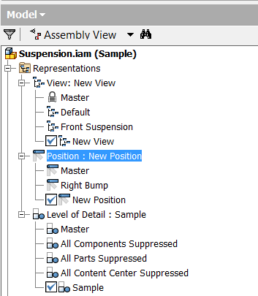
Assembly Representations
Includes
Design views
Positional representations
Level of details

Slide 22
Design View Representations Example
Public Sub DesignViewSample()
Dim oAsmDef As AssemblyComponentDefinition
oAsmDef = _InvApplication.ActiveDocument.ComponentDefinition
Dim oDesignViewReps As DesignViewRepresentations
oDesignViewReps = oAsmDef.RepresentationsManager.DesignViewRepresentations
' Use ComponentOccurrence functionality to set the state, (visibility, color, etc.).
' When the design view is created it will capture the current state of the assembly.
Dim oDesignViewRep As DesignViewRepresentation
oDesignViewRep = oDesignViewReps.Add("Test")
' Activate the master design view.
oDesignViewReps.Item("Master").Activate()
End Sub
Notes:
Public Sub DesignViewSample()
Dim oAsmDef As AssemblyComponentDefinition
Set oAsmDef = ThisApplication.ActiveDocument.ComponentDefinition
Dim oDesignViewReps As DesignViewRepresentations
Set oDesignViewReps = oAsmDef.RepresentationsManager.DesignViewRepresentations
' Use ComponentOccurrence functionality to set the state, (visibility, color, etc.).
' When the design view is created it will capture the current state of the assembly.
Dim oDesignViewRep As DesignViewRepresentation
Set oDesignViewRep = oDesignViewReps.Add("Test")
' Activate the master design view.
oDesignViewReps.Item("Master").Activate
End Sub

Slide 23
Positional Representations Example
Public Sub PositionalRepSample()
Dim oAsmDoc As AssemblyDocument
oAsmDoc = _InvApplication.ActiveDocument
Dim oAsmDef As AssemblyComponentDefinition
oAsmDef = _InvApplication.ActiveDocument.ComponentDefinition
Dim oPositionalReps As PositionalRepresentations
oPositionalReps = oAsmDef.RepresentationsManager.PositionalRepresentations
' Create a new position representation.
Dim oPosRep As PositionalRepresentation
oPosRep = oPositionalReps.Add("New Test")
' Get a constraint and override it's value.
Dim oConstraint As AssemblyConstraint
oConstraint = oAsmDoc.ComponentDefinition.Constraints.Item(1)
Call oPosRep.SetConstraintValueOverride(oConstraint, "1 in")
End Sub
Notes:
Public Sub PositionalRepSample()
Dim oAsmDef As AssemblyComponentDefinition
Set oAsmDef = ThisApplication.ActiveDocument.ComponentDefinition
Dim oPositionalReps As PositionalRepresentations
Set oPositionalReps = oAsmDef.RepresentationsManager.PositionalRepresentations
' Create a new position representation.
Dim oPosRep As PositionalRepresentation
Set oPosRep = oPositionalReps.Add("New Test")
' Get a constraint and override it's value.
Dim oConstraint As AssemblyConstraint
Set oConstraint = oAsmDoc.ComponentDefinition.Constraints.Item(1)
Call oPosRep.SetConstraintValueOverride(oConstraint, "1 in")
End Sub

Slide 24
Level of Detail Representations Example
Public Sub PositionalRepSample()
Dim oAsmDoc As AssemblyDocument
oAsmDoc = _InvApplication.ActiveDocument
Dim oAsmDef As AssemblyComponentDefinition
oAsmDef = _InvApplication.ActiveDocument.ComponentDefinition
Dim oPositionalReps As PositionalRepresentations
oPositionalReps = oAsmDef.RepresentationsManager.PositionalRepresentations
' Create a new position representation.
Dim oPosRep As PositionalRepresentation
oPosRep = oPositionalReps.Add("New Test")
' Get a constraint and override it's value.
Dim oConstraint As AssemblyConstraint
oConstraint = oAsmDoc.ComponentDefinition.Constraints.Item(1)
Call oPosRep.SetConstraintValueOverride(oConstraint, "1 in")
End Sub
Notes:
Public Sub LevelOfDetail()
Dim oAsmDef As AssemblyComponentDefinition
Set oAsmDef = ThisApplication.ActiveDocument.ComponentDefinition
Dim oLODReps As LevelOfDetailRepresentations
Set oLODReps = oAsmDef.RepresentationsManager.LevelOfDetailRepresentations
' Create a new level of detail.
Dim oLODRep As LevelOfDetailRepresentation
Set oLODRep = oLODReps.Add("My LOD")
' Suppress an occurrence.
oAsmDef.Occurrences.Item(1).Suppress
' Save the document, which is really saving the LOD.
ThisApplication.ActiveDocument.Save
' Activate the master LOD.
oAsmDef.RepresentationsManager.LevelOfDetailRepresentations.Item("Master").Activate
End Sub

Slide 25
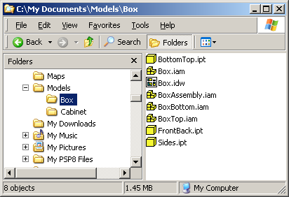
Level of Detail Internals
The File object represents a file on disk and a File can contain multiple documents.
Each Level of Detail correspond to a specific Document within the same File.
All files have a default document so treating a Document as a file on disk will work in most cases.
File
DrawingDocument
File
AssemblyDocument
AssemblyDocument
File
File
PartDocument
PartDocument

Slide 26
Level of Detail - Filenames
Document.FullFilename property returns the filename of the file the document is contained within.
Document.FullDocumentName property returns a document name which is the filename concatenated with the level of detail name.
For example: “C:\Temp\Assembly1.iam<BigParts>”
A special case is the Master level of detail. Supplying or getting back a full document name that consists of only the filename implies the “Master” level of detail.
oAsmDoc = oDocuments.Open("C:\Temp\Assembly1.iam")
'Is equivalent to:
oAsmDoc = oDocuments.Open("C:\Temp\Assembly1.iam<Master>“)
Notes:
Set oAsmDoc = oDocuments.Open(“C:\Temp\Assembly1.iam”)
Is equivalent to:
Set oAsmDoc = oDocuments.Open(“C:\Temp\Assembly1.iam<Master>”)

Slide 27
LoD and Assembly Properties
Getting some properties requires to get them from the master LOD only, otherwise the returned object won’t be valid. E.g. BOM and MassProperties.
Public Sub BOMfromLoD()
Dim oDoc As AssemblyDocument
oDoc = _InvApplication.ActiveDocument
Dim oAsmDocMasterLOD As AssemblyDocument
oAsmDocMasterLOD = _InvApplication.Documents.Open(oDoc.File.FullFileName, False)
'Obtains BOM only from Master LOD
Dim oBOM As BOM
oBOM = oAsmDocMasterLOD.ComponentDefinition.BOM
'From here you can operate on the BOM object...
'Following lines of code are examples only
oBOM.StructuredViewFirstLevelOnly = True
oBOM.StructuredViewEnabled = True
End Sub
Notes:
Public Sub BOMfromLoD()
Dim oDoc As AssemblyDocument
Set oDoc = ThisApplication.ActiveDocument
Dim oAsmDocMasterLOD As AssemblyDocument
Set oAsmDocMasterLOD = ThisApplication.Documents.Open(oDoc.File.FullFileName, False)
'Obtains BOM only from Master LOD
Dim oBOM As BOM
Set oBOM = oAsmDocMasterLOD.ComponentDefinition.BOM
'From here you can operate on the BOM object...
'Following lines of code are examples only
oBOM.StructuredViewFirstLevelOnly = True
oBOM.StructuredViewEnabled = True
End Sub

Slide 28
References - Access
Document:
AllReferencedDocuments As DocumentsEnumerator
ReferencedDocumentDescriptors As DocumentDescriptorsEnumerator
ReferencedDocuments As DocumentsEnumerator
ReferencedOLEFileDescriptors As ReferencedOLEFileDescriptors
ReferencingDocuments As DocumentsEnumerator
File:
AllReferencedFiles As FilesEnumerator
AvailableDocuments As DocumentsEnumerator (in Inventor) and ApprenticeServerDocuments (in Apprentice)
ReferencedFileDescriptors As FileDescriptorsEnumerator
ReferencedFiles As FilesEnumerator
ReferencingFiles As FilesEnumerator

Slide 29
Replacing References
The new referenced File must have the same heritage as the File being replaced: Usually a modified copy of the original.
Can directly edit the reference information using Inventor or Apprentice. (The Design Assistant utility is built on Apprentice and uses this functionality.)
Indirectly modify references within Inventor by replacing occurrences.
Public Sub ReplaceReferences()
Dim oDoc As AssemblyDocument
oDoc = _InvApplication.ActiveDocument
oDoc.File.ReferencedFileDescriptors(1).ReplaceReference("C:\CopyPart.ipt")
End Sub
Notes:
'/////////////////////////////////////////////////////////////////////////////////////////////////////////////
'// Sample
'//
'// Use: Copy & Replace assembly references (1st Level refs only)
'/////////////////////////////////////////////////////////////////////////////////////////////////////////////
Public Sub ReplaceReference()
Dim oAsm As AssemblyDocument
Set oAsm = ThisApplication.ActiveDocument
Dim oNewRefDoc As Document
Dim filename As String
Dim oFileDesc As FileDescriptor
For Each oFileDesc In oAsm.File.ReferencedFileDescriptors
Set oNewRefDoc = oFileDesc.ReferencedFile.AvailableDocuments(1)
filename = "C:\Temp\Copy-" + oNewRefDoc.DisplayName
Call oNewRefDoc.SaveAs(filename, True)
Call oFileDesc.ReplaceReference(filename)
Next
filename = "C:\Temp\Copy-" + oAsm.DisplayName
Call oAsm.SaveAs(filename, True)
Call oAsm.Close(True)
End Sub

Slide 30
File References with Apprentice (1/2)
Apprentice offers a convenient way to move an assembly to a new location and save it along with its references.
Dim mApprenticeApp As Inventor.ApprenticeServerComponent = _
New ApprenticeServerComponent()
Private Sub SaveWithApprentice()
Dim NewFolder As String = "C:\Temp\"
Dim AsmFullFilename As String = _
"C:\Program Files\Autodesk\Inventor 2013\Samples\Models\Tube & Pipe\Tank\Tank.iam"
Dim oApprenticeDoc As Inventor.ApprenticeServerDocument = _
mApprenticeApp.Open(AsmFullFilename)
SaveRec(NewFolder, oApprenticeDoc)
mApprenticeApp.FileSaveAs.ExecuteSaveCopyAs()
oApprenticeDoc.Close()
End Sub
Notes:
Private Sub Save()
Dim NewFolder As String = "C:\Temp\"
Dim AsmFullFilename As String = _
"C:\Program Files\Autodesk\Inventor 2009\Samples\Models\Tube & Pipe\Tank\Tank.iam"
Dim oApprenticeDoc As Inventor.ApprenticeServerDocument = _
mApprenticeApp.Open(AsmFullFilename)
SaveRec(NewFolder, oApprenticeDoc)
mApprenticeApp.FileSaveAs.ExecuteSaveCopyAs()
oApprenticeDoc.Close()
End Sub

Slide 31
File References with Apprentice (2/2)
Please note: Saving of files in Apprentice is not allowed on files that require migration
Private Function newFileName(ByVal FullFileName As String) As String
Dim fileInfo As New IO.FileInfo(FullFileName)
Return fileInfo.Name.Substring(0, fileInfo.Name.Length - 4) + "_new" + fileInfo.Extension
End Function
Private Sub SaveRec(ByRef NewFolder As String, ByRef oApprenticeDoc As ApprenticeServerDocument)
Dim NewFullFilename As String = NewFolder + newFileName(oApprenticeDoc.FullFileName)
Try
mApprenticeApp.FileSaveAs.AddFileToSave(oApprenticeDoc, NewFullFilename)
For Each oRefDoc As ApprenticeServerDocument In oApprenticeDoc.ReferencedDocuments
SaveRec(NewFolder, oRefDoc)
Next
Catch
'Content Center Parts will fail
End Try
End Sub
Notes:
Notes: AddFileToSave Method
Adds a document, taken from within this tree, to the set of documents to be saved. Please note: Saving of files in Apprentice is not allowed on files that require migration (any file that has not already been migrated to the same version of the Apprentice server). The current document's NeedsMigrating property must return False before the FileSaveAs object can successfully be returned.
Private Function newFileName (ByVal FullFileName As String) As String
Dim fileInfo As New IO.FileInfo (FullFileName)
Return fileInfo.Name.Substring (0, fileInfo.Name.Length - 4) + "_new" + fileInfo.Extension
End Function
Private Sub SaveRec (ByRef NewFolder As String, ByRef oApprenticeDoc As ApprenticeServerDocument)
Dim NewFullFilename As String = NewFolder + newFileName (oApprenticeDoc.FullFileName)
Try
mApprenticeApp.FileSaveAs.AddFileToSave (oApprenticeDoc, NewFullFilename)
For Each oRefDoc As ApprenticeServerDocument In oApprenticeDoc.ReferencedDocuments
SaveRec (NewFolder, oRefDoc)
Next
Catch
'Content Center Parts will fail
End Try
End Sub

Slide 32
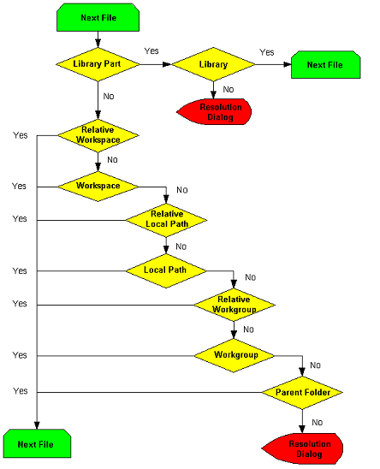
How Inventor resolves File References?

Slide 33
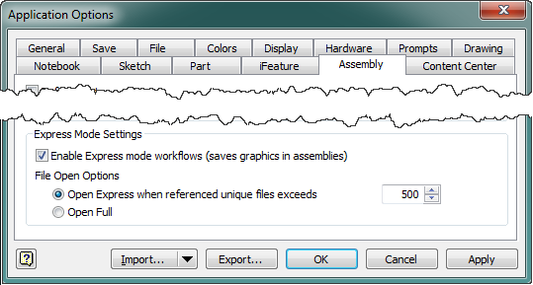
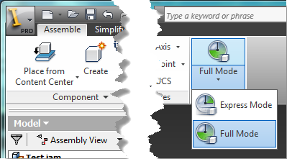
Assembly – Express Mode (from 2014)
AssemblyDocument.IsOpenExpress
Documents.LoadedCount
Application.AssemblyOptions
ExpressAssemblyMinimumUniqueDocuments
IsExpressAssemblyEnabled
Application.AssemblyEvents
OnLoadStateChange
Notes:
This is big ebanchment our engineer team has focused on in this year, There is not much API inpacted. Express mode, the idea is you can open
Aassembly in express mode that is a lot faster, how does it work
When you save the assembly, you can save it to express mode. It will save the
Graphics information to the assembly. now, if you arein the express mode
And open the assembly, you have the option to open in express or full mode. because the graphics info is there, you will not need to load the asembly, part
Load limiated info of the assembly, only the graphics.
In the UI, you have the swtich express . Full model, API basically expose
The option. We also added an event that to indicate if the mode is being swtiched
Ther
When the express mode, you cannot add more part until siwtching to full mode,

Slide 34

Notes:
Thank you!
Questions?

